Slide 1

MA-220 PARTIAL DIFFRENTIAL EQUATION
Real-life Applications of
Poission Equation
Presented By :
1) Parth Modi (B23499)
2) Arendra Kumar (B23394)

Slide 2
Content
1
Solving 2D Poisson Equation with Point Singularities Using PINNs
2
Poisson Image Editing

Slide 3

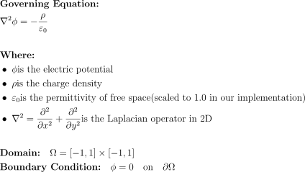
Problem Statement
Project Objetives
Implement a PINN to solve the 2D Poisson equation with point charge singularities.
Compare the PINN solution with the analytical solution
Visualize the electric potential and electric field.
Analyze the performance of different network architectures and training strategies.
Develop advanced visualization techniques for electric field and potential.

Slide 4
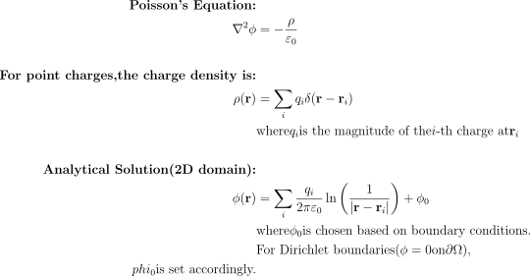

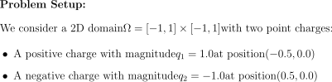
Analytic Solution

Slide 5

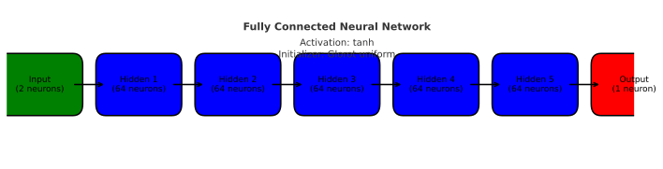
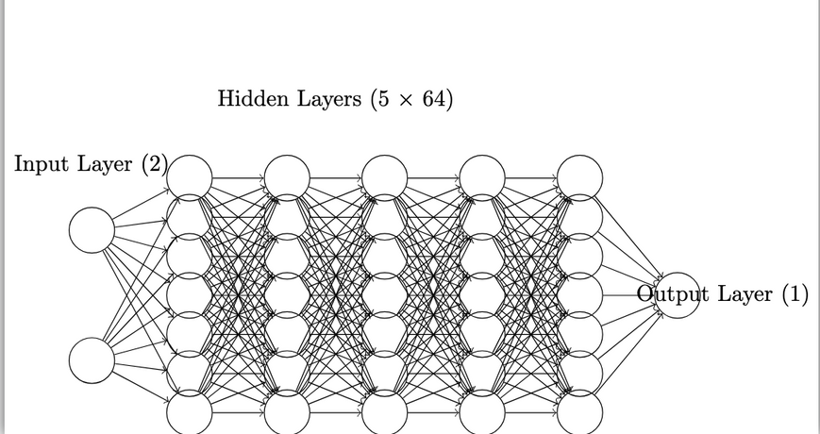
PINN Architecture

Slide 6
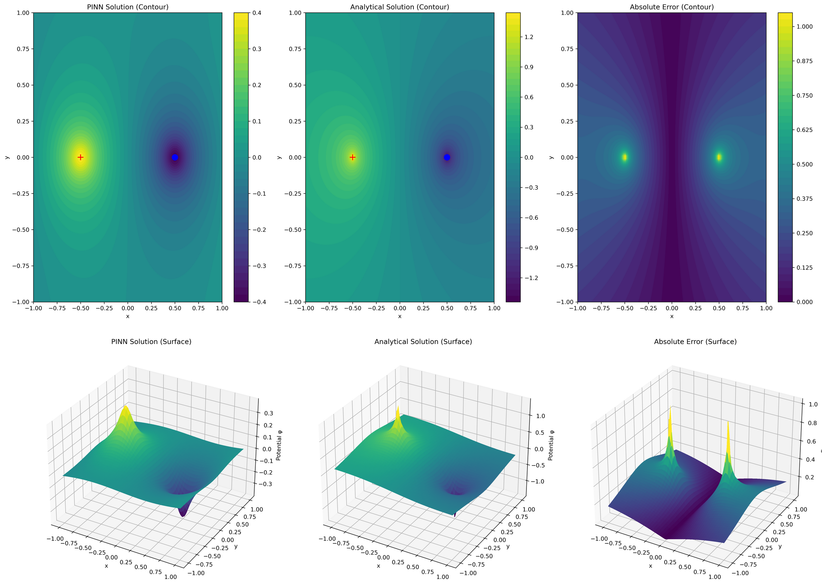
Result and Analysis

Slide 7
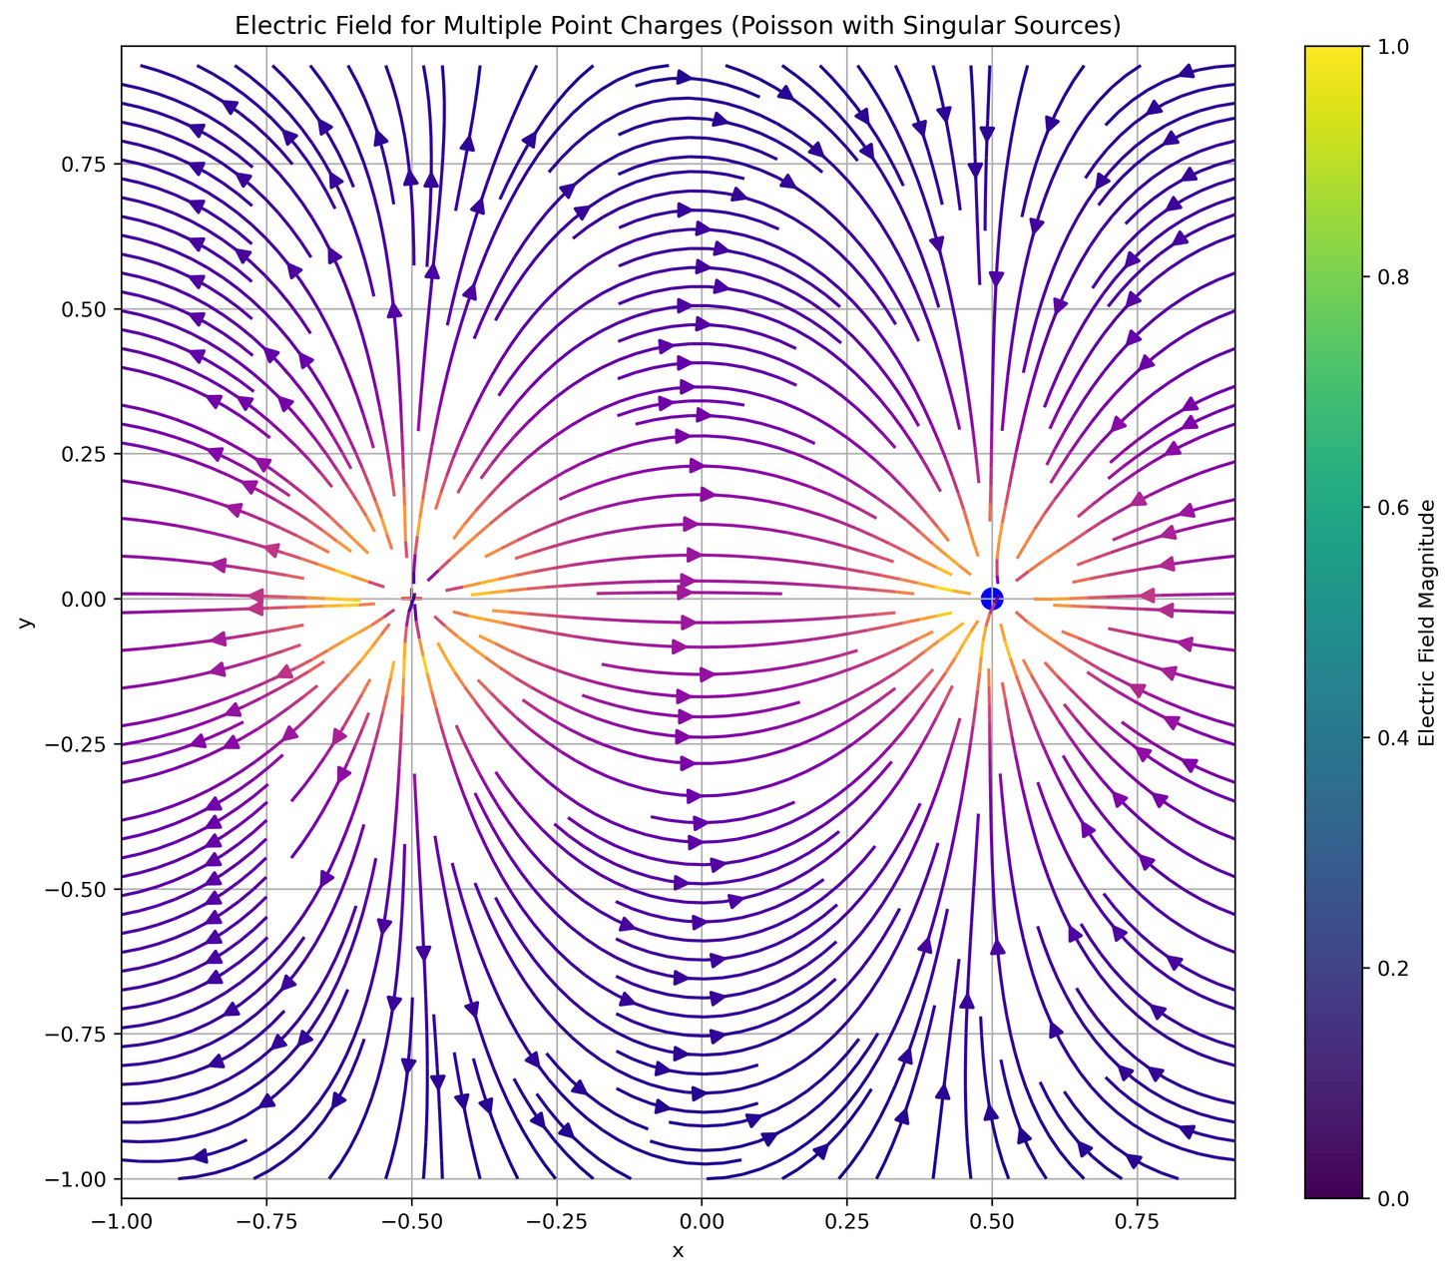
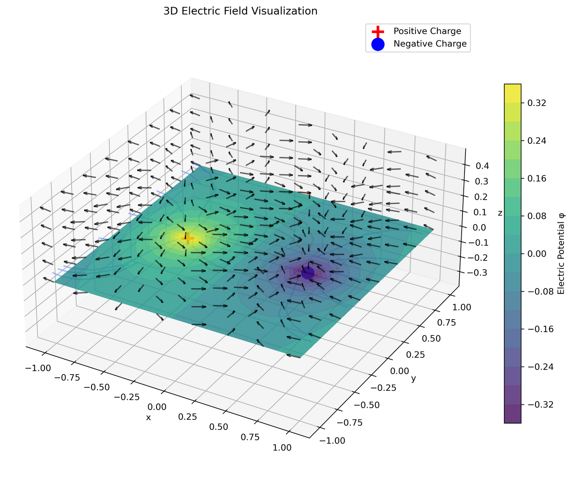

Slide 8
Poisson’s Image Editing
The Mathematical Foundation
Poisson image editing is based on solving the Poisson equation:
Δf = div(v) inside the domain
f = f* on the boundary
Where:
f is the unknown function (our edited image)
v is the guidance vector field (gradients from source image)
f* provides boundary conditions (values from target image)
Δ is the Laplacian operator

Slide 9






Importance
Computation
The
Core
Principle
Copy the gradient field from your source image
(the part you want to insert)
Solve the Poisson equation to find new pixel values in the target region that match these gradients
Ensure that the boundary conditions match the target image for seamless integration

Slide 10
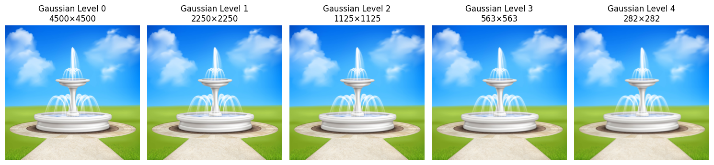
Let’s move on to the implementation...
Image Pyramids Reconstruction
Step-1 : Constructing Gaussian Pyramid

Slide 11

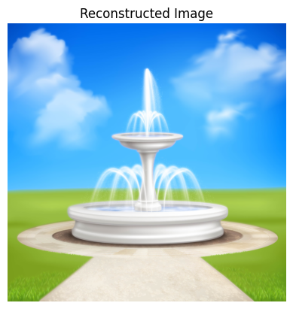
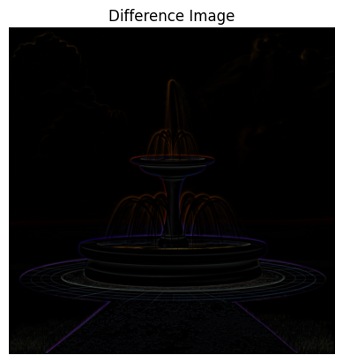
What does this construction changed ?

Slide 12
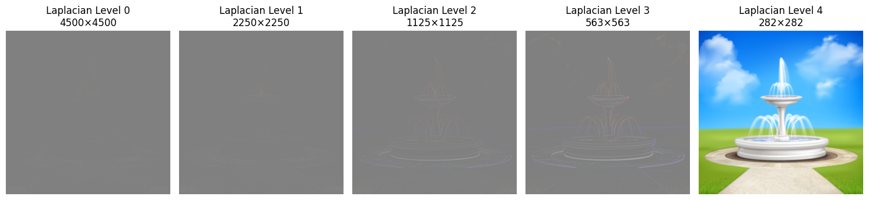
Image Pyramids Reconstruction
Step-2 : Constructing Laplacian Pyramid

Slide 13
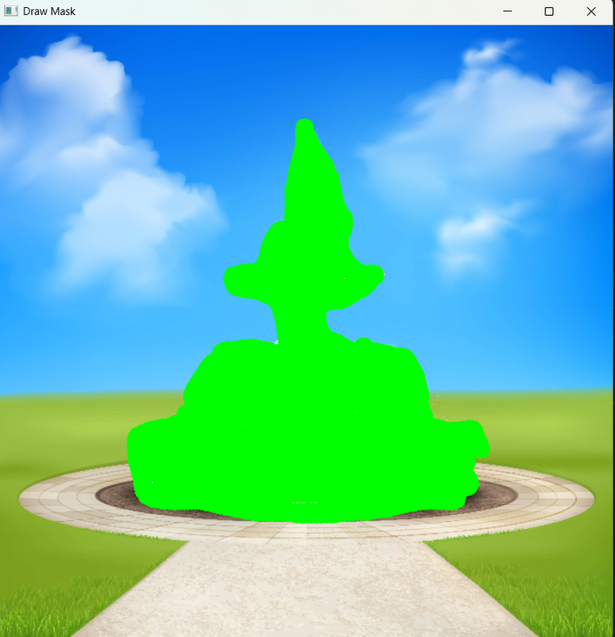

Mask Construction
Position the source image on target

Slide 14
Now, Apply the Poisson Blend
Technique to find new pixels in the target region.....
Solve the Poisson equation to find new pixel values in the target region that match these gradients

Slide 15

See
the
Magic...

Slide 16



Intuition...
Poisson editing preserves "how things change" (gradients) rather than "what they are" (pixel values), which is kinda its advantage and disadvantage as well.

Slide 17

Thank You

